Slide 1
Distributed Task Allocation in Mobile Device Cloud Exploiting Federated Learning and Subjective Logic
MS Thesis Defense
Presented By :
Palash Roy
Registration No: 2015-516-785
Dept of CSE, University of Dhaka
Supervised By :
Prof. Dr. Md. Mamun-Or-Rashid
Prof. Dr. Md. Abdur Razzaque
Dept of CSE, University of Dhaka

Slide 2
Presentation Outline
Introduction
Research Objectives
Related Works
Contributions
Proposed System
Proposed Methodology
Conclusion

Slide 3
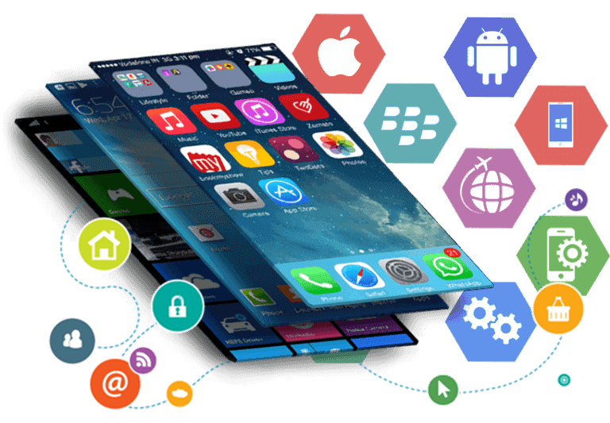
Introduction
Applications
- Image processing
- Face recognition
- Text translation
- Real-time multimedia
Sensing
Augmented Reality
Fig: Application Downloaded
[*] “Mobile App Usage Overview”, Access Date: 22 January, 2022, Available: https://www.statista.com/statistics/266488/forecast-of-mobile-app-downloads/
Notes:
With the advancement of mobile computing technologies computation intensive mobile applications like pattern or gesture recognition, health monitoring and diagnosis, mobile biometric, reality augmentation, video and image processing etc. are very much common mobile applications. A recent study shows that around 178 billion apps were downloaded in 2017 predicted that to grow to 258 billion by 2022 giving a massive increase in just five years. And the projected revenue from these apps will increase 120% in the next five years.

Slide 4
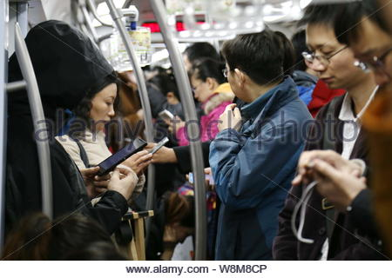
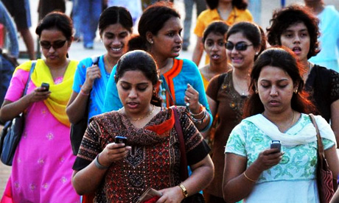
Mobile Device Cloud
Plethora of Mobile Devices
In a bus/ train
On the move
In the stadium
In the shopping center
In the movie theater
Fig: Application Downloads
Notes:
With the advancement of mobile computing technologies computation intensive mobile applications like pattern or gesture recognition, health monitoring and diagnosis, mobile biometric, reality augmentation, video and image processing etc. are very much common mobile applications. A recent study shows that around 178 billion apps were downloaded in 2017 predicted that to grow to 258 billion by 2022 giving a massive increase in just five years. And the projected revenue from these apps will increase 120% in the next five years.

Slide 5
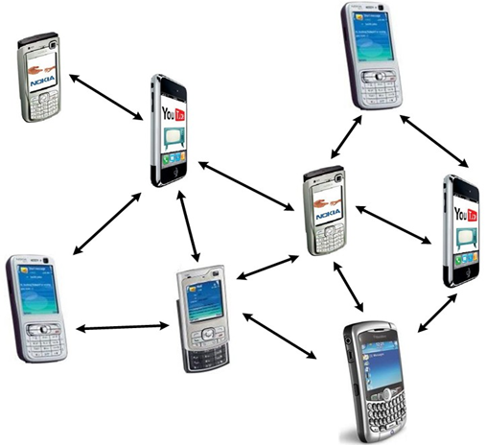
Mobile Device Cloud
- CPU Power
- Memory Size
- Storage Space
- Limited Bandwidth
- Battery Lifetime
-Quality of Service
-Quality of Experience
- Energy
Fig: Mobile Device Cloud (MDC)
Notes:
However, mobile devices suffer from resource constraints like low CPU power, insufficient memory and storage size, limited bandwidth and limited battery power. As a result, execution of these applications on mobile devices, most of the time, is not feasible for various issues i.e. delay, energy, QoS etc.

Slide 6
Mobile Device Cloud
Cloud Based Offloading
Cloudlet Based Offloading
Mobile Device Cloud
Notes:
With the advancement of mobile computing technologies computation intensive mobile applications like pattern or gesture recognition, health monitoring and diagnosis, mobile biometric, reality augmentation, video and image processing etc. are very much common mobile applications. A recent study shows that around 178 billion apps were downloaded in 2017 predicted that to grow to 258 billion by 2022 giving a massive increase in just five years. And the projected revenue from these apps will increase 120% in the next five years.

Slide 7
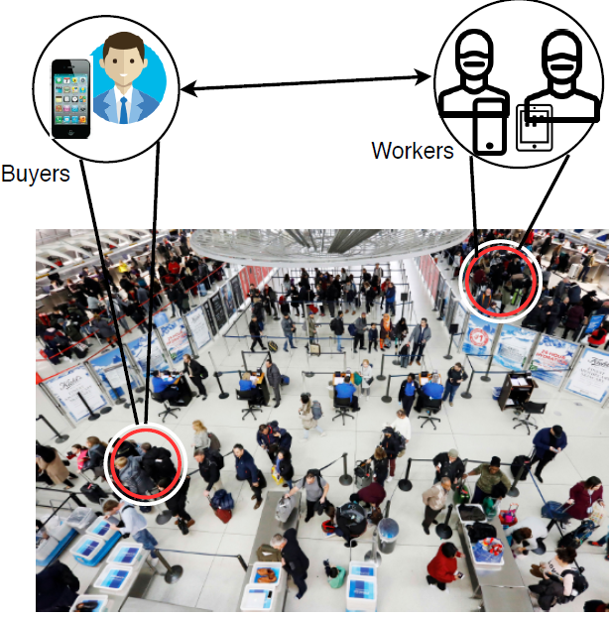
Problem Statement
How to select reliable workers by considering their reputation in the distributed MDC environment?
How to design an incentive mechanism that motivates workers to share their unused resources while ensuring Quality-of-Experience (QoE)?
How to ensure the truthfulness of both entities?

Slide 8
Research Objectives
Selecting worker devices that,
Maximize Quality-of-Experience (QoE) of buyers
Maximize utility
Considering
Resource Capacity
Worker’s availability
Worker’s reputation
Designing an Incentive mechanism based on
High data quality
Higher QoE

Slide 9
Related Works
Stackelberg game-theoretical model [1]
Allocating the task and determining the payments
Doesn’t capture the preference of the task
Doesn’t consider heterogeneous nature of tasks
[1] X. Wang, X. Chen, W. Wu, N. An, L. Wang, “Cooperative application execution in mobile cloud computing: a Stackelberg game approach,” IEEE Communications Letters, vol. 20, no. 5, pp. 946–949, 2016.

Slide 10
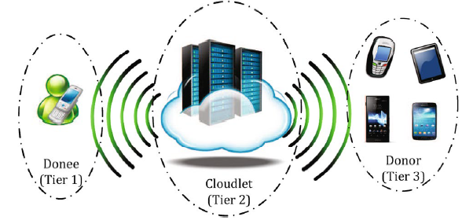
Related Works
Trade-off between the execution speedup and selection of reliable worker device [2]
Requires Centralized auctioneer
Worker devices need to participate spontaneously
Have not provided any payment
Fig: Computation architecture in Mobile Device Cloud
[2] S. Saha, M. A. Habib, T. Adhikary, M. A. Razzaque, and M. M. Rahman, “Tradeoff between execution speedup and reliability for compute-intensive code offloading in mobile device cloud," Multimedia Systems, vol. 25, no. 5, pp. 577-589, 2019.
Notes:
have made a trade-off between the execution speedup and selection of reliable worker devices in the MDC environment. However, In their environment, worker devices need to participate in the MDC system spontaneously. Workers have not provided any payment for the execution of the tasks.
Circa [22] has offloaded the tasks to some mobile devices within the same vicinity. Their main target is to identify a group of mobile devices to do the same offloading task. However, they have not considered the energy level of those mobile devices.

Slide 11
Related Works
Proposed truthful incentive model (TIM) for resource sharing [3]
Guarantees truthfulness of the buyers and workers
Perform well for homogenous platform
One-to-one resource trading model
Doesn't consider that resource rich mobile devices can support multiple
buyers.
Requires Centralized Auctioneer.
[3] A. Jin, W. Song, P. Wang, D. Niyato, and P. Ju, “Auction mechanisms toward efficient resource sharing for cloudlets in mobile cloud computing," IEEE Transactions on Services Computing, vol. 9, no. 6, pp. 895-909, 2016.
.

Slide 12
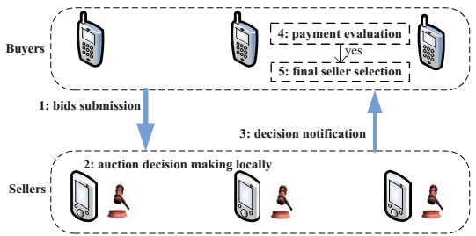
Related Works
Proposed Distributed truthful auction model (DTAM) [4]
Requires no centralized auctioneer or cloudlet.
Buyers submit their bids privately
Workers make auction decisions locally
Haven’t considered the reputation of the
workers
Have not considered user Quality-of-
Experience (QoE) and quality of the executed
task.
[4] X. Wang, Y. Sui, J. Wang, C. Yuen, and W. Wu, “A distributed truthful auction mechanism for task allocation in mobile cloud computing," IEEE Transactions on Services Computing, pp. 1-1, 2018.

Slide 13
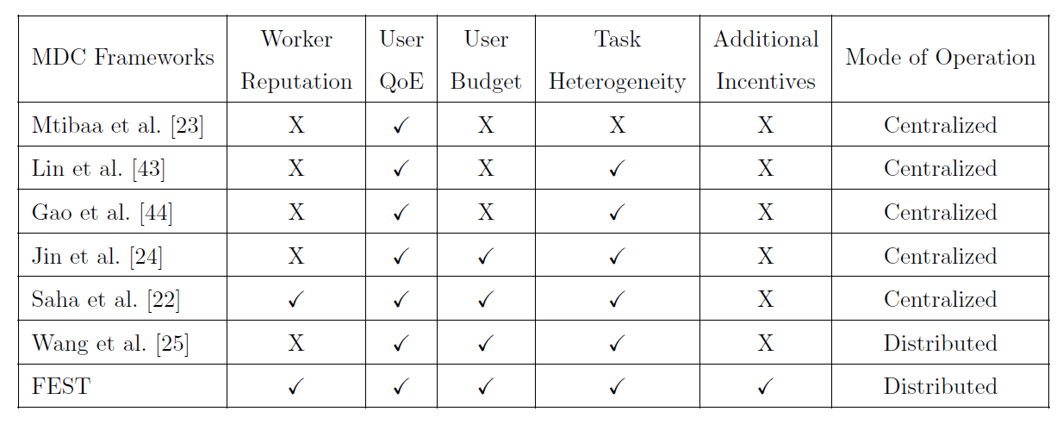
Related Works
Table: Summary of the Task Execution Approaches in MDC
.

Slide 14
Contribution
Design Distributed Mobile Device Cloud framework, FEST
Calculate worker reputation using Multi-Weight Subjective Logic (MWSL) and Federated Learning (FL)
Develop distributed auction mechanism to select worker devices
Develop QoE aware Incentive mechanism
Perform theoretical analysis of truthfulness, individual rationality, and budget balance
Perform Comparative result analysis of state-of-the-art works.

Slide 15
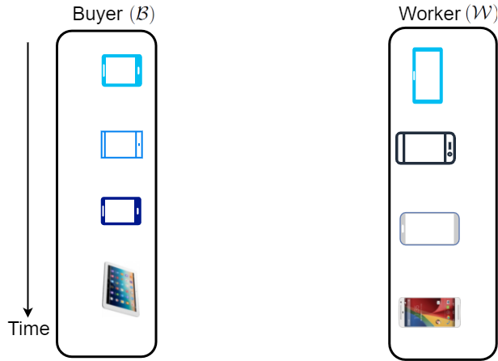
Distributed Auction Model
1. Bid Submission
3. Auction Decisions
5. Worker Selection Notification
4. Payment Evaluation and Worker
Selection
2. Auction decisions are made locally
6. Result Submission
7. Make Payments
Fig: Distributed Auction Model

Slide 16
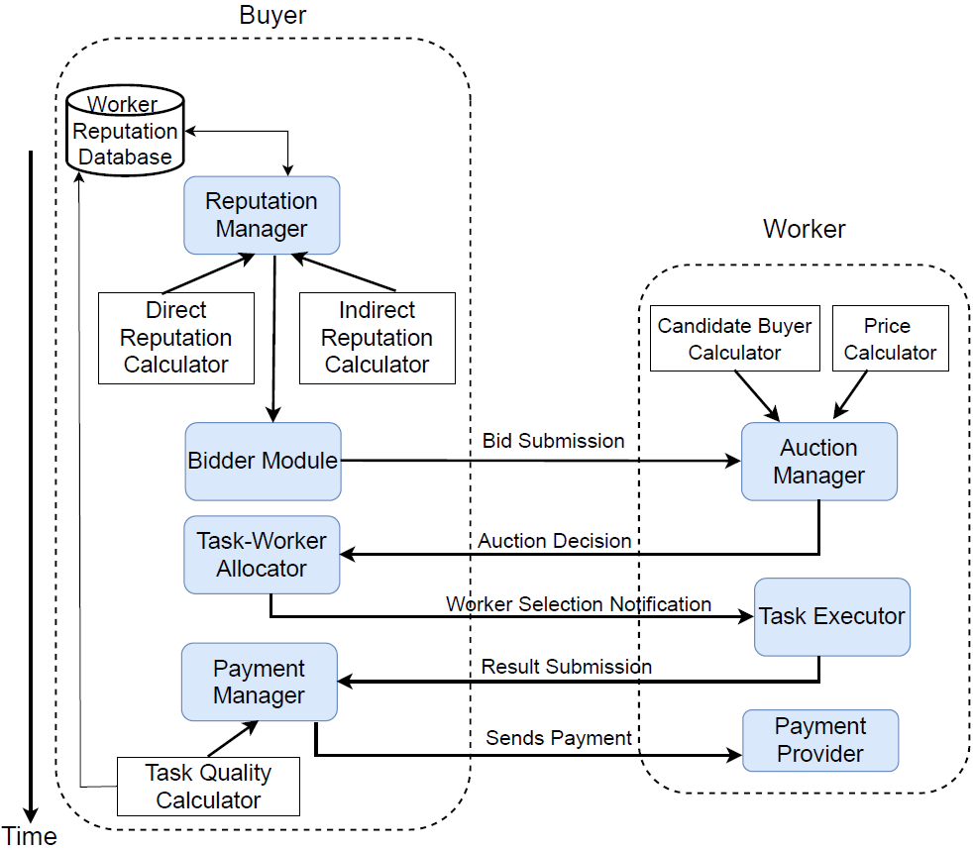
Computational Model
Fig: Computational Framework of FEST System

Slide 17
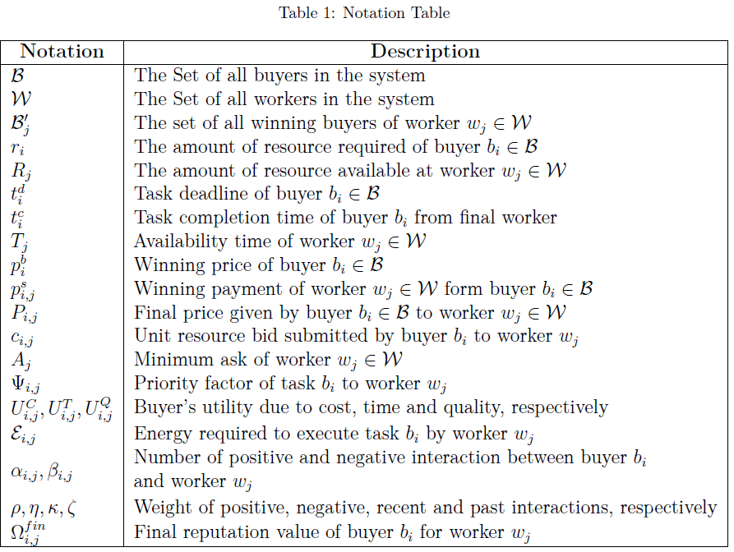
List of Notations

Slide 18
System Workflow
Calculation of Worker Reputation
Auction Decision at Worker
Worker Selection
Payment policy of workers
Theoritical Analysis

Slide 19
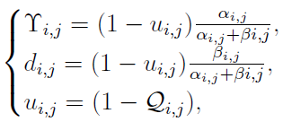
Calculation of Worker Reputation (1/6)
Calculate workers reputation
Multi-weight Subjective Logic
Federated Learning
Belief
Disbelief
Uncertainty
Base Rate
Number of Positive Interaction
Number of Negative Interaction

Slide 20
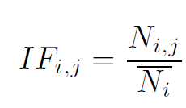
Calculation of Worker Reputation (2/6)
Multi-weight Subjective Logic
Interaction Frequency
Interaction Effects
Positive Interaction Weights ( )
Negative Interaction Weights () )

Slide 21
Calculation of Worker Reputation (3/6)
Interaction Freshness
Recent Interaction Weights ( )
Past Interaction Weights ( )

Slide 22
Calculation of Worker Reputation (4/6)
Interaction Frequency can be written as :
Interaction Similarity

Slide 23
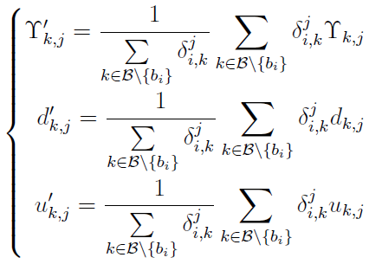
Calculation of Worker Reputation (5/6)
Federated Learning on Worker Reputation
Recommended from recommenders

Slide 24
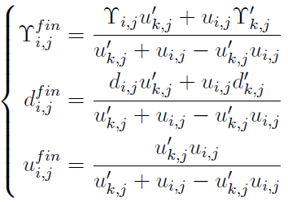
Calculation of Worker Reputation (6/6)
Final Reputation of Workers
Cumulative Fusion Rule

Slide 25
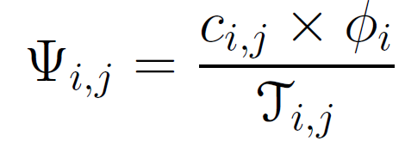
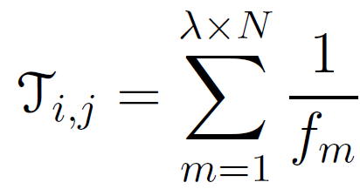
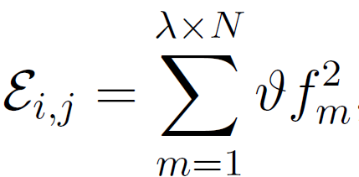
Auction Decision at Worker (1/3)
Calculation of priority factor
Calculation of Execution time
Task Preference
Execution time
Bit size of an application
CPU frequency
Calculation of Energy

Slide 26
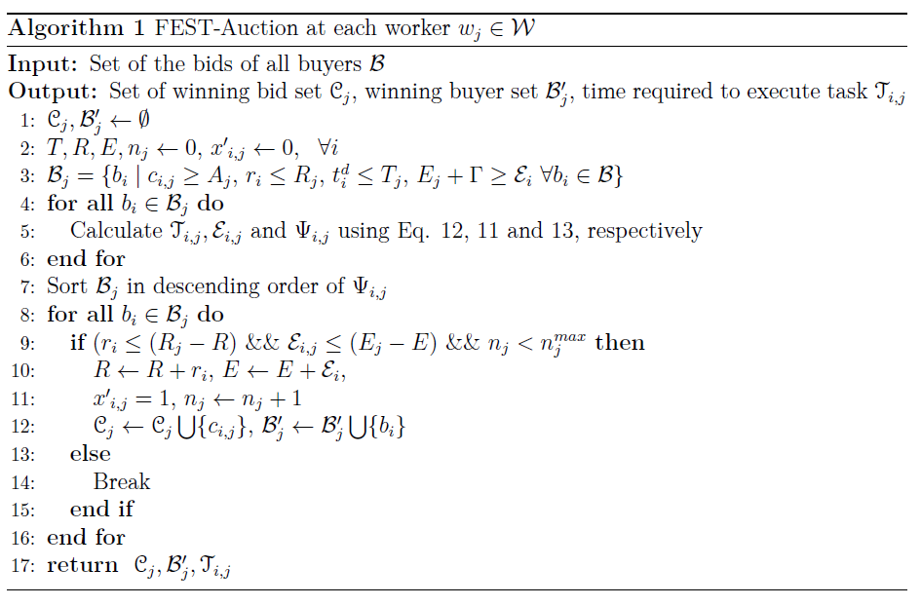
Auction Decision at Worker (2/3)
Number of Buyers

Slide 27
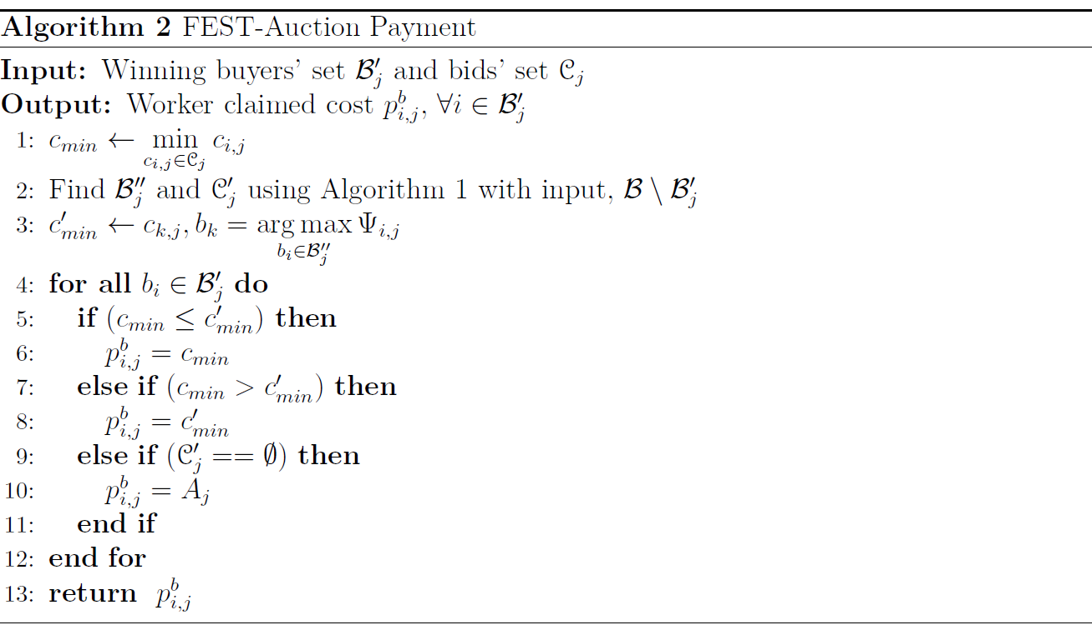
Auction Decision at Worker (3/3)
Number of Buyers

Slide 28
Worker Selection (1/3)
Utility Calculation
Cost Based Utility
Time Based Utility
Reputation Based Utility
Calculation of utility

Slide 29
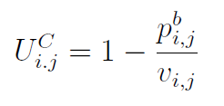
Worker Selection (2/3)
Calculation of utility
Cost-Based Utility
True cost of a task
Time Based Utility
Execution time
Task delay deadline
Worker reputation
Combined Utility

Slide 30
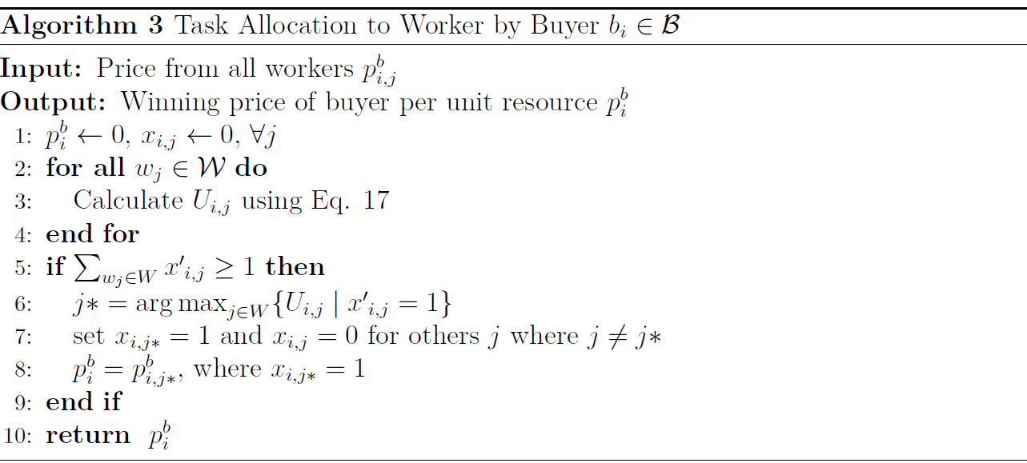
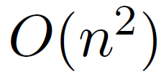
Worker Selection (3/3)
Number of Workers

Slide 31
Payment policy for workers (1/2)
Quality deviation of a task
Final payment of worker
Estimated value of a task
True value of a task
Reward Point
Penalty Factor

Slide 32
Payment policy for workers (1/2)
Maximum allowable
deviation
Reward Calculation
Penalty Calculation
Here, are the scaling factor.
True cost of a task

Slide 33
Theoretical Analysis
Theorem 1: FEST-Auction mechanism run in polynomial time.
Complexity of FEST-Auction
Complexity of FEST-Auction Payment
Complexity of Task Allocation to worker
Theorem 2: FEST-Auction is individually rational.
Theorem 3: FEST-Auction is Truthful to the buyer and worker devices.
Proof by lemma for buyers and workers individually.
Theorem 4: FEST-Auction is budget balanced.
Notes:
Mobile Device Cloud (MDC) where compute-intensive application tasks are offloaded to nearby mobile devices. The key philosophy of this MDC technology is to exploit the underutilized resources of nearby mobile devices. Since executors in MDC are located closer to the initiators, the energy consumption, communication latency or response delay have been reduced significantly compared to cloud based solutions.

Slide 34
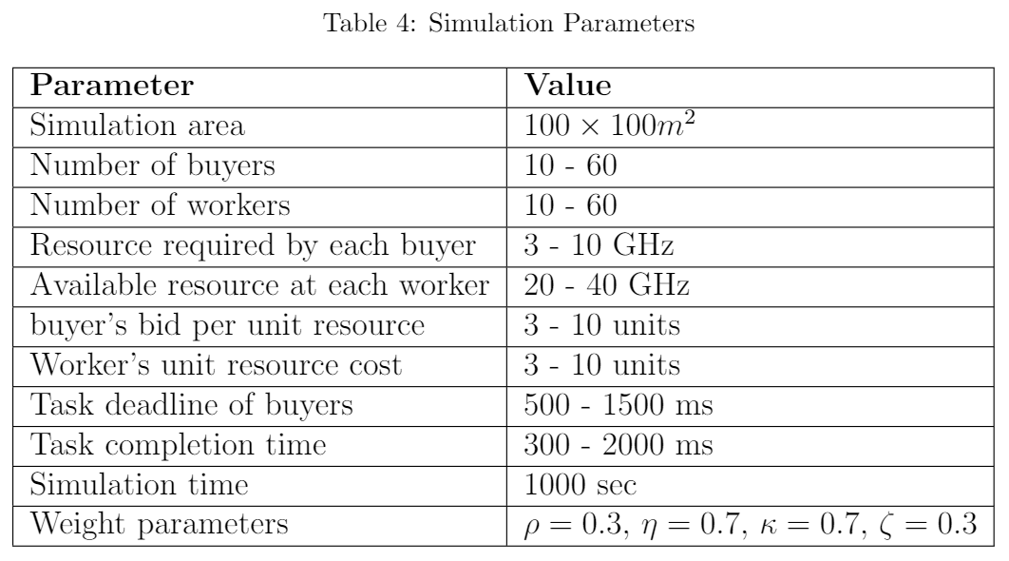
Performance Evaluation
Performance Analysis Using Python 3.7

Slide 35
Performance Evaluation
Performance Metrics
Average Quality-of-Experience
Average Utility per buyer
Task Completion Ratio (%)
Average payment of workers
Parameters
Varying the number of workers
Varying the number of buyers
Present comparative results with state-of-the-art works TIM [13] and DTAM [15]
Github Link: https://github.com/PalashRoy975/ThesisCodes
[13] A. Jin, W. Song, P. Wang, D. Niyato, and P. Ju, “Auction mechanisms toward efficient resource sharing for cloudlets in mobile cloud computing," IEEE Transactions on Services Computing, vol. 9, no. 6, pp. 895-909, 2016.
.
[15] X. Wang, Y. Sui, J. Wang, C. Yuen, and W. Wu, “A distributed truthful auction mechanism for task allocation in mobile cloud computing," IEEE Transactions on Services Computing, pp. 1-1, 2018.

Slide 36
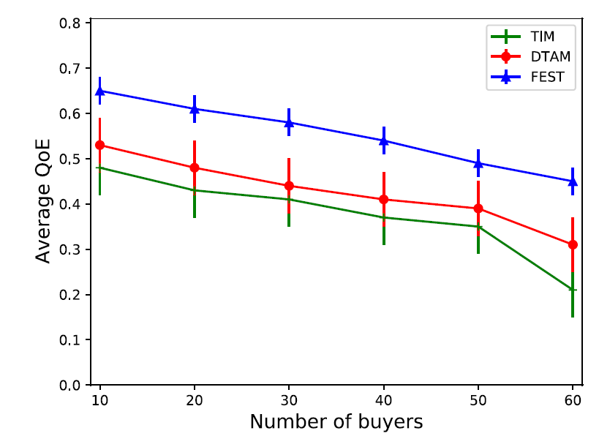
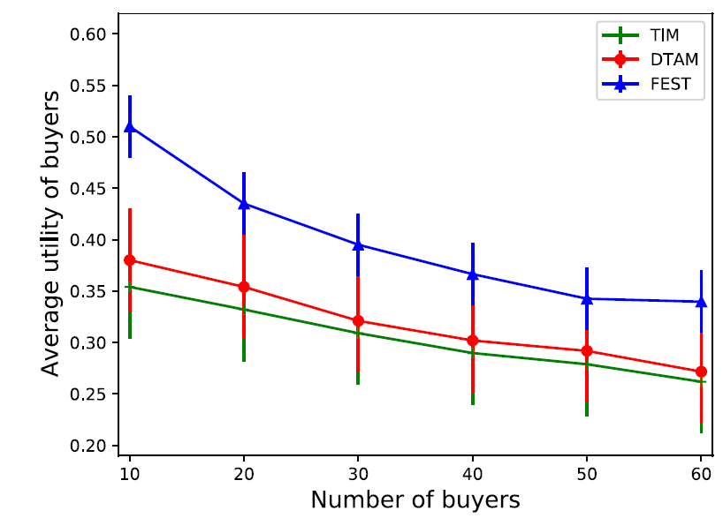
Performance Evaluation
Impact of a varying number of buyers
Number of workers = 30
Highest QoE
Highest Utility
Selection of highly reputed workers helps to improve QoE and Utility
Fig: Average QoE of the buyers Fig: Average utility of the buyers

Slide 37
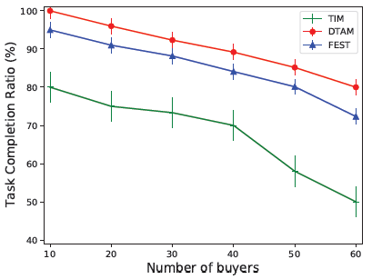
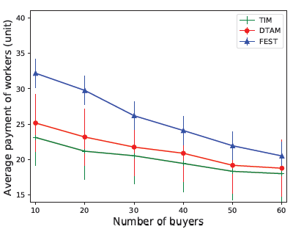
Performance Evaluation
Impact of a varying number of buyers
Number of workers = 30
Add Incentives Along With Regular Payment
Have not considered device energy
and worker’s preference
Fig : Task completion ratio Fig: Average payment of the workers

Slide 38
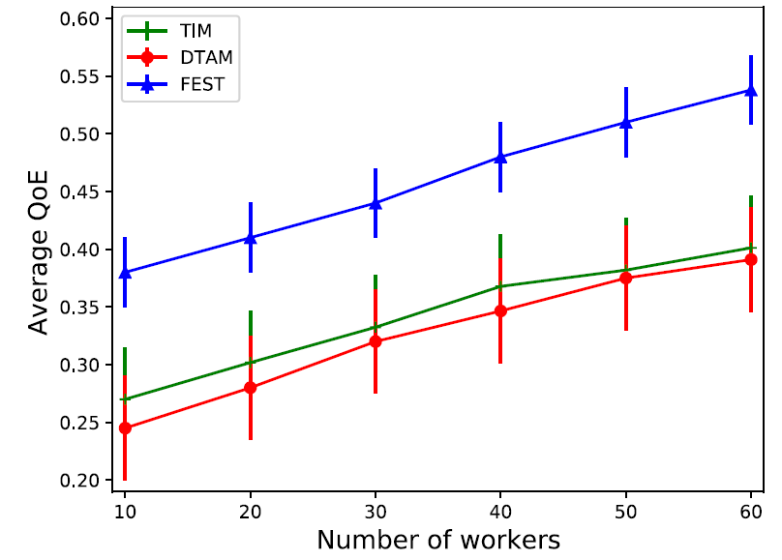
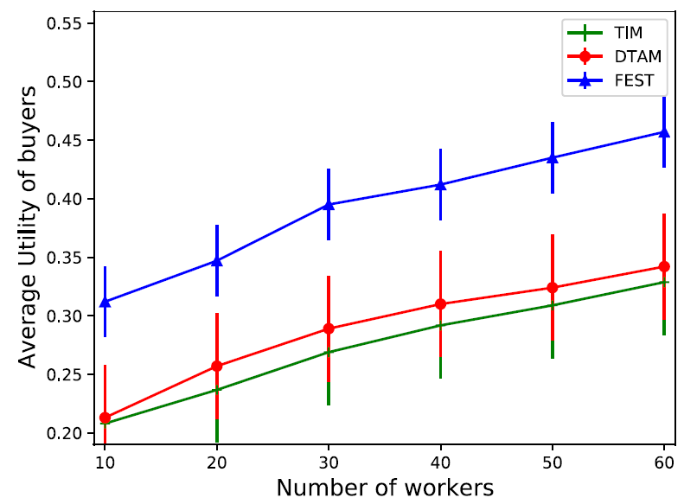
Performance Evaluation
Impact of varying number of workers
Number of buyers = 30
More high-quality workers get selected
Fig: Average QoE of the buyer’s Fig: Average utility of the buyers

Slide 39
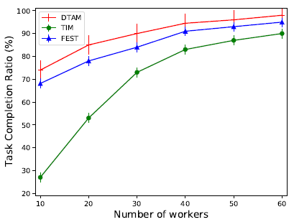
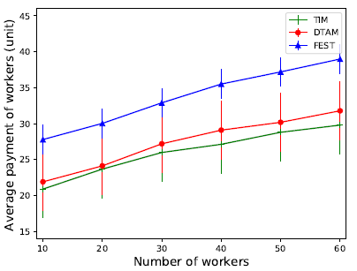
Performance Evaluation
Impact of varying number of workers
Number of buyers = 30
Workload Allocation Opportunity Increases
Fig: Task completion ratio Fig: Average payment of the workers

Slide 40
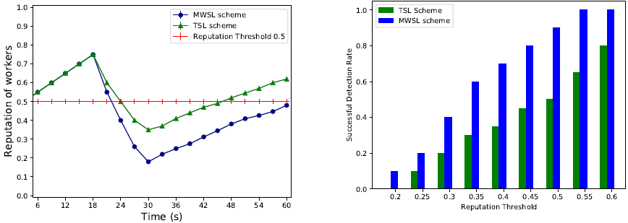
Performance Evaluation
Simulation Time = 60 Sec
Reputation Threshold = 0.5
Initial Reputation Value = 0.5
Impact of Worker Reputation
Fig : Reputation Value of Worker Fig : Detection Rate of Untruthful Workers
More Accurate and Sensitive for Reputation Calculation

Slide 41
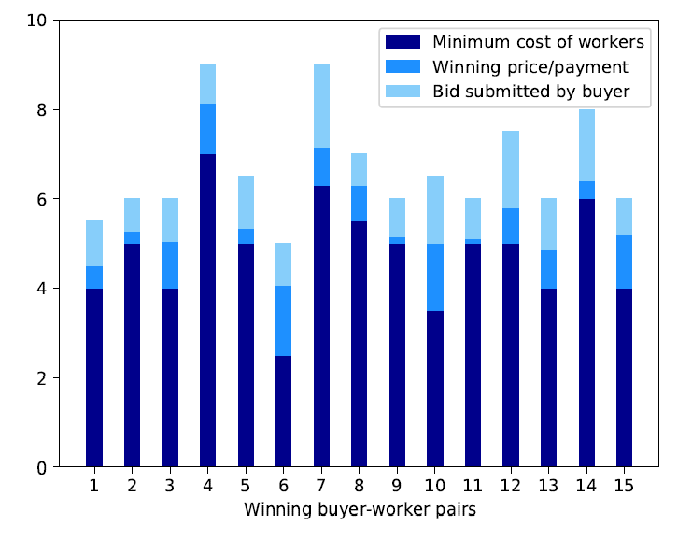
Performance Evaluation
Impact of Individual Rationality
Fig : Impact on Individual Rationality

Slide 42
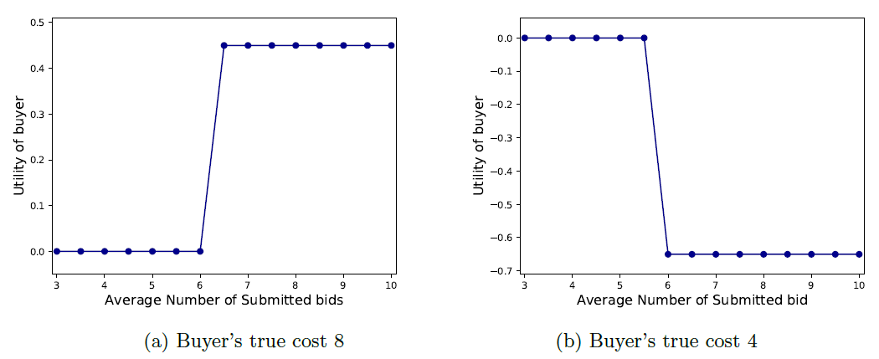
Performance Evaluation
Impact of Truthfulness of Buyers
Fig: Impact on Truthfulness of the Buyers
Untruthful bids can not maximize the utility of buyers then the truthful case

Slide 43
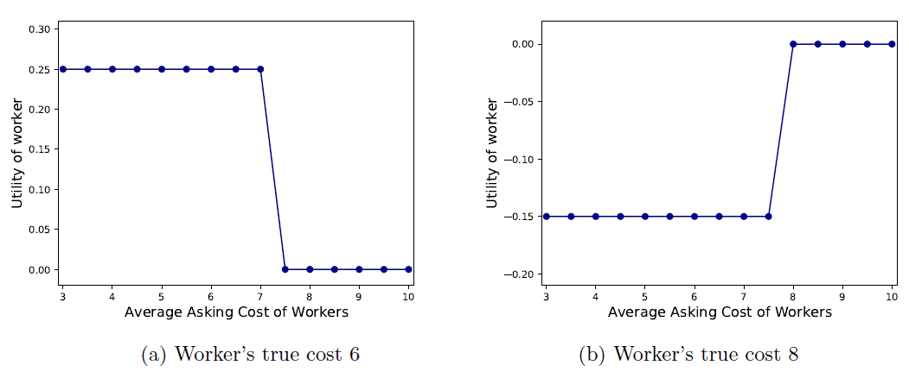
Performance Evaluation
Impact of Truthfulness of Workers
Fig: Impact on Truthfulness of the Workers
Untruthful asks can not maximize the utility of workers then the truthful case

Slide 44
Conclusion
Proposed Distributed task allocation framework FEST
Distributed Auction Mechanism was devised
Proposed Federated learning on subjective logic-based worker
reputation
Theoretical analysis on individually rational, truthful to the buyers and
workers, and budget balance.
Improves QoE and Utility of the buyers as high as 30% and 25%,
respectively

Slide 45
Future Plans
Learning the contextual behavior of buyers and worker devices
using Deep Learning approaches.
Dynamic Pricing updates of different buyers and workers following the demand supply theory of economics can be another interesting problem.

Slide 46
List of Publications
Palash Roy, Sujan Sarker,Md. Abdur Razzaque, Md. Mamun-or-Rashid, Mohammad Mehedi Hassan, Giancarlo Fortino, “Distributed Task Allocation in Mobile Device Cloud Exploiting Federated Learning and Subjective Logic”, Journal of System Architecture (Elsevier) (2021), doi: https://doi.org/10.1016/j.sysarc.2020.101972
2. Palash Roy, Anika Tahsin, Sujan Sarker, Tamal Adhikary, Md. Abdur Razzaque, Mohammad Mehedi Hassan, “User mobility and Quality-of-Experience aware placement of Virtual Network Functions in 5G”, Computer
Communications (Elsevier) (2020), vol. 150, pp. 367 – 377,doi: https://doi.org/10.1016/j.comcom.2019.12.005.
Palash Roy, Sujan Sarker, Md.Abdur Razzaque, Mohammad Mehedi Hassan, Salman AlQahtani, Gianluca Aloi,
Giancarlo Fortino, “AI-enabled Mobile Multimedia Service Instance Placement Scheme in Mobile Edge Computing,”
Computer Networks (Elsevier) (2020), vol. 182,doi: https://doi.org/10.1016/j.comnet.2020.107573.
Md. Rajibul Palas, Md. Rakibul Islam, Palash Roy, Md. Abdur Razzaque, Ahmad Alsanad, Salman AlQahtani, Mohammad
Mehedi Hassan, “Multi-criteria handover mobility management in 5G cellular network”, Computer Communications
(Elsevier) (2021), vol. 174, pp. 81 – 91,doi: https://doi.org/10.1016/j.comcom.2021.04.020
Rushmita H. Chaity, Palash Roy, Md. Abdur Razzaque, M. Sadiquzzaman, “Enhancing Quality of Experience of 5G Users Exploiting Deep Q-Learning”, 2021 3rd International Conference on Sustainable Technologies for Industry 4.0 (STI), 18-19 Dec, 2021, Dhaka, Bangladesh. [Best Paper Award]
Amena Zahan Prithibi, Syeda Kanij Faria, Palash Roy, Md. Abdur Razzaque, “Network Lifetime Aware Routing
Algorithm for Energy Harvesting Wireless Sensor Networks”, 2020 2nd International Conference on Sustainable
Technologies for Industry 4.0 (STI), 19-20 Dec 2020, Dhaka, Bangladesh.
7. Mozdaher Abdul Quader, Montaser Abdul Quader, Palash Roy, Md. Abdur Razzaque, “A Hybrid Approach for Routing Path Computation in Software Defined Ultra Dense Network”, 2020 2nd International Conference on Sustainable
Technologies for Industry 4.0 (STI), 19-20 Dec 2020, Dhaka, Bangladesh.

Slide 47
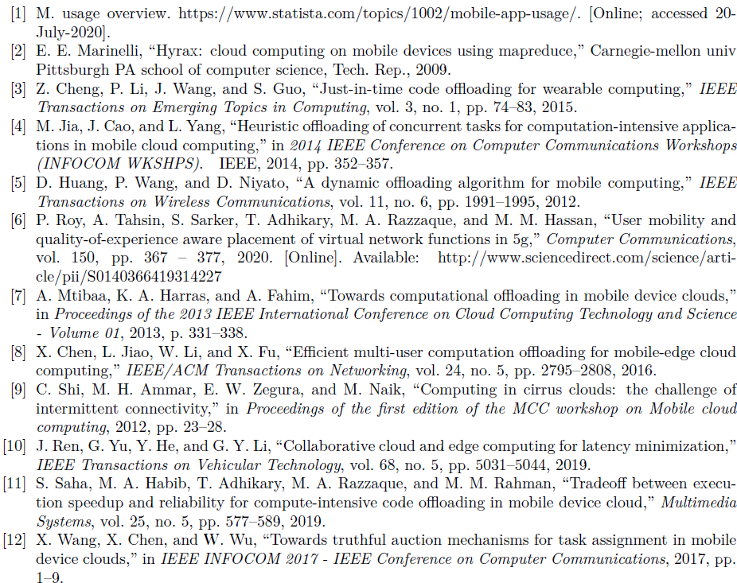
References

Slide 48
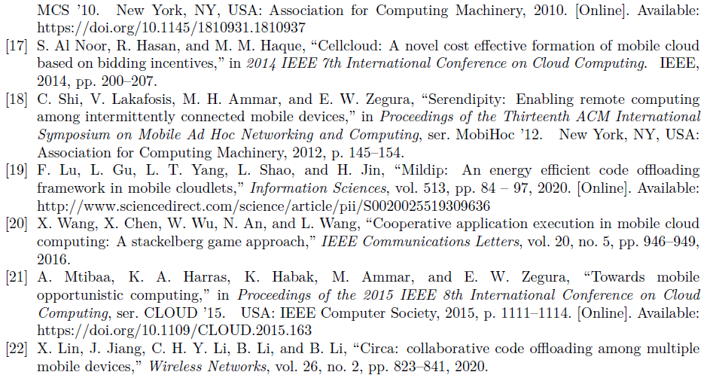
References

Slide 49
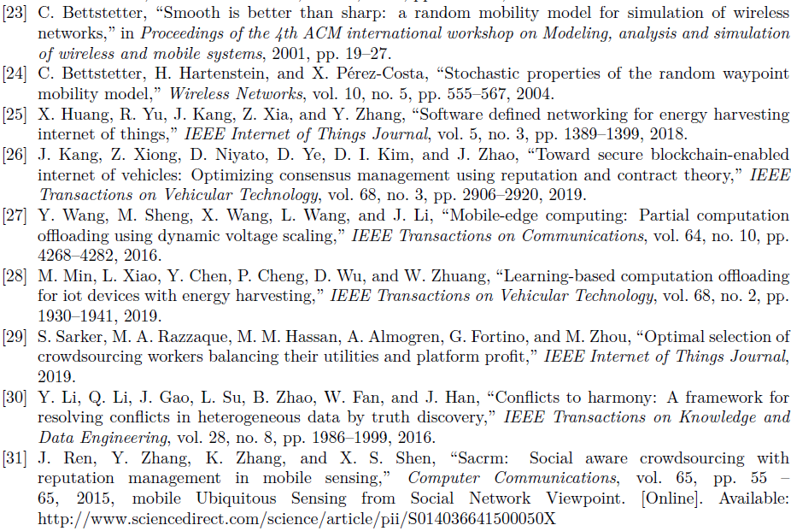
References

Slide 51
Any Question ?

